Slide 1
Insurance Analytics
Group 1
Presented by:-
    Rohit Joshi
    Dipesh Gajra
    Ganesh U
    Vennu C

Slide 2
Index
Introduction
Objectives
Tools used for Data analysis and their limitations
Dashboard
Findings
Conclusion

Slide 3
Introduction
Insurance Analytics project explains how the use of the advanced data analysis tools like Advanced excel, SQL, Power Bi, Tableau helps in the insurance industry to lead the better risk assessment, more accurate pricing, enhanced fraud detection and improved customer experiences.

Slide 4
Objectives
Prepare the dashboard as per the KPI’s given below:-
                1-No of Invoice by Account Exec
                2-Yearly Meeting Count
                3.1Cross Sell--Target, Achieve, new
                3.1New-Target,Achive,new
                3.1Renewal-Target, Achieve , new
                4. Stage Funnel by Revenue
                5. No of meeting By Account Exe
                6- Top Open Opportunity

Slide 5
Tools used for Data analysis and their limitations
1:- Excel
Limitations of excel:- Limited charting options for visual designing
2:- SQL
Limitations of SQL:- No built-in visualization capability leads to lack of visualization capabilities
3:- Power BI
Limitations of Power Bi:- Slow performance with large data sets
4:- Tableau Public
Limitations of Tableau Public :- Only allows access to the local data sources, being able to publish publicly only, and no data automation

Slide 6
Dashboard

Slide 7
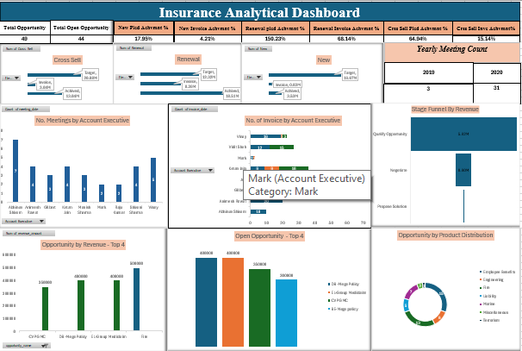
Excel Dashboard

Slide 8
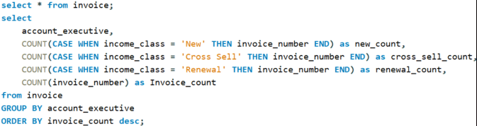
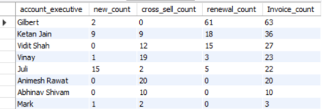
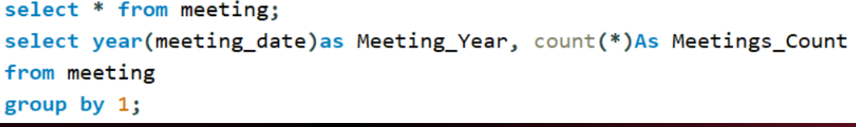
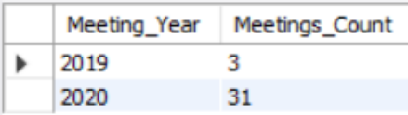
SQL Queries
KPI 1 :- No. of Invoice by Account Exec
Output
KPI 2 :- Yearly Meeting Count
Output

Slide 9
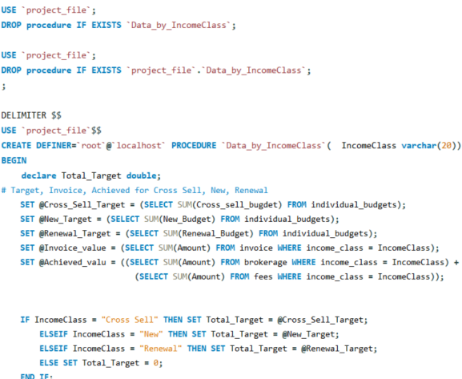
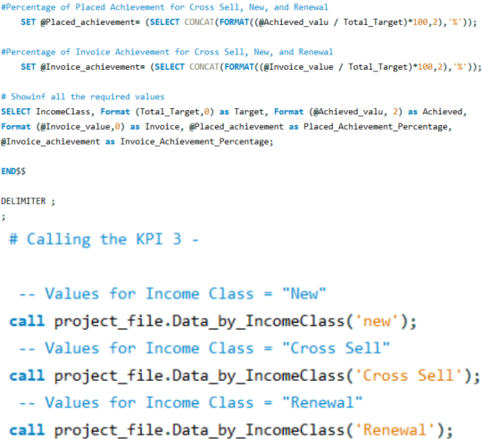
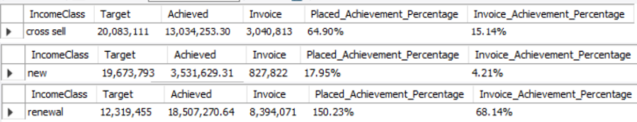
KPI 3 :- Placed Achievement %, Invoice Achievement % in Cross sell, New & Renewal
Output

Slide 10
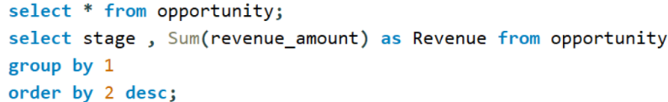
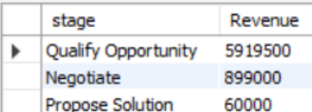
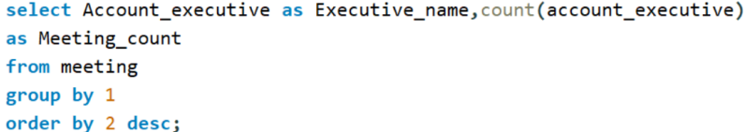
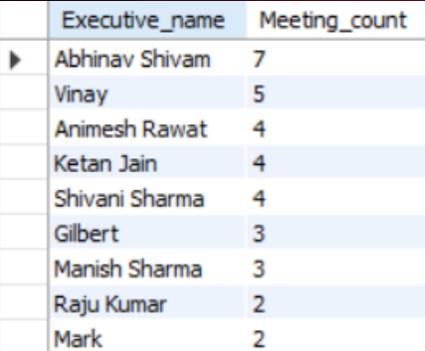
KPI 2 :- Stage Funnel by Revenue
Output
KPI 2 :- No. of Meeting by Account Exec
Output

Slide 11
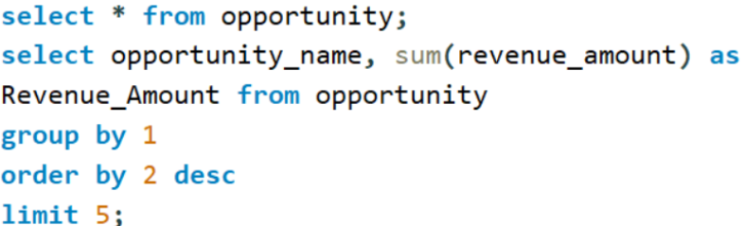
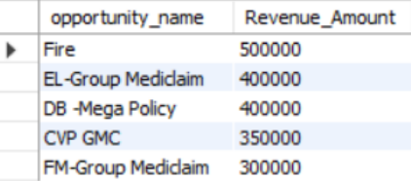
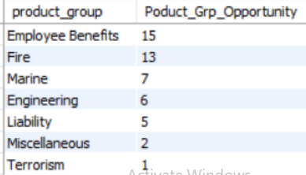
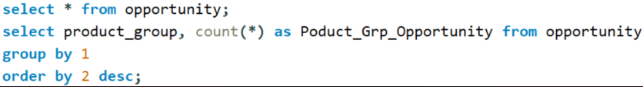
KPI 6 :- Top Open Opportunity
Output
Opportunity Product Distribution
Output

Slide 12
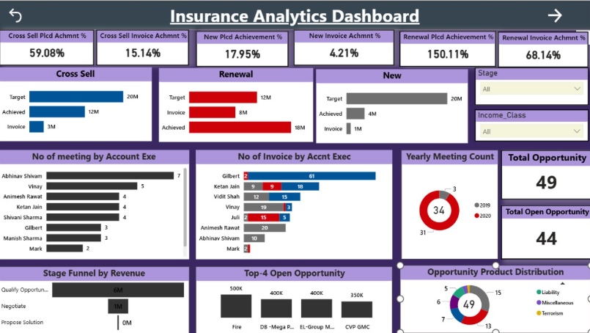
Power BI Dashboard

Slide 13
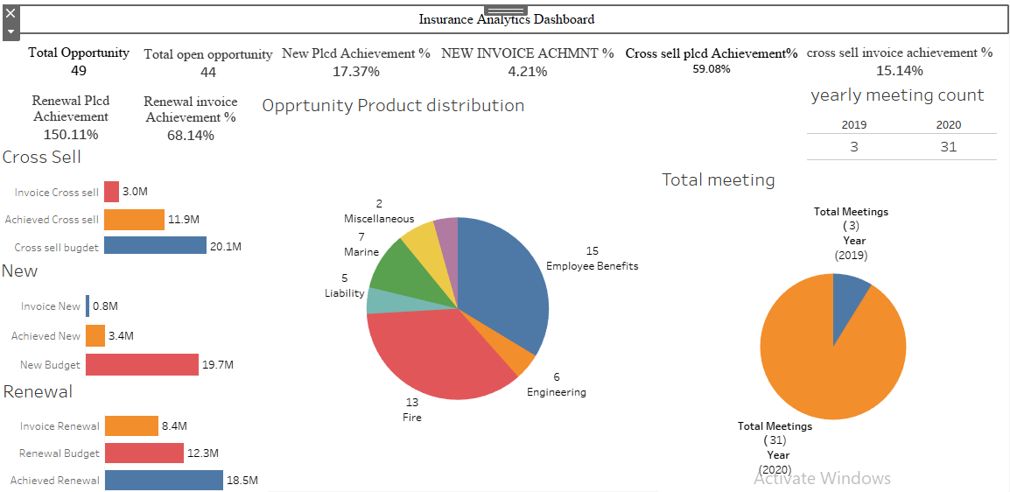
Tableau Dashboard (1)

Slide 14
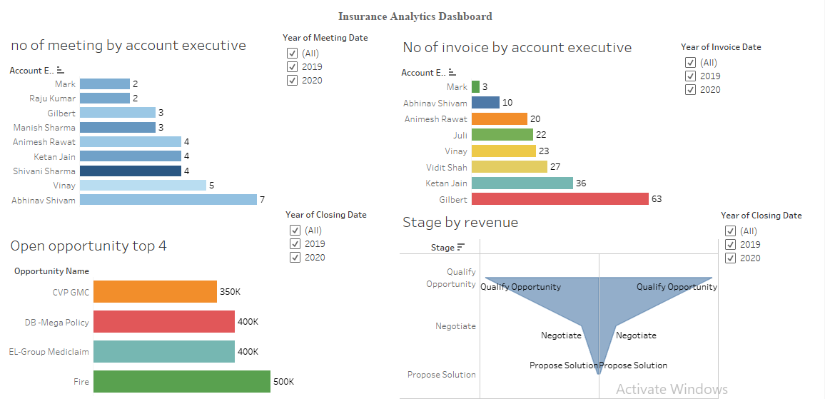
Tableau Dashboard (2)

Slide 15
Findings
KPI 1 represents the no. of invoice by an account executive
KPI2 represents the yearly meeting count where in 2019 “3” meetings were conducted and in 2020 “31” meetings were conducted
KPI 3 represents the Placed Achievement %, Invoice Achievement % in Cross sell, New & Renewal
KPI 4 represents the Stage funnel by revenue
KPI 5 represents the No of meetings by an account executive
KPI 6 represents the Top open opportunities

Slide 16
Conclusion
KPI 1 :- Mark has the least no. of invoices where as gilbert has the highest no of invoices by account executive
KPI 2 :- yearly meeting count where in 2019 “3” meetings were conducted and in 2020 “31” meetings were conducted
KPI 3 :- New Placed achievement is 17.37%, New Invoice achievement is 4.21%, Cross sell Placed achievement is 59.08%, Cross sell Invoice achievement is 15.14%, Renewal Placed achievement is 150.11%, Renewal Invoice achievement is 68.14%
KPI 4:- Propose solution has the least revenue (60000) where as Qualify opportunity has the highest revenue (5919500)
KPI 5 :- Mark has least no of meetings (2) where as Abhinav Shivam has the highest no of meetings (7) as an account executive
KPI 6 :- Fire, EL group Mediclaim, DB mega Policy & CVP GMC are the top 4 open opportunities

